Slide 1

Digital Storytelling: From Traditional Tales to Interactive E-Books
Discover how to transform cultural heritage into engaging digital content through e-book creation and flipbook design.

Slide 2
Our Learning Journey
01
02
Create an E-Book
Discover Cultural Heroes
Compile traditional folk tales featuring beloved characters like Nasreddin Hodja into a digital format.
Share iconic characters from your own culture and learn about storytelling traditions worldwide.
03
04
Master Flipbook Technology
Apply to Your Curriculum
Transform static PDFs into dynamic, page-turning digital experiences.
Create subject-specific e-books that bring science and arts education into the digital age.

Slide 3
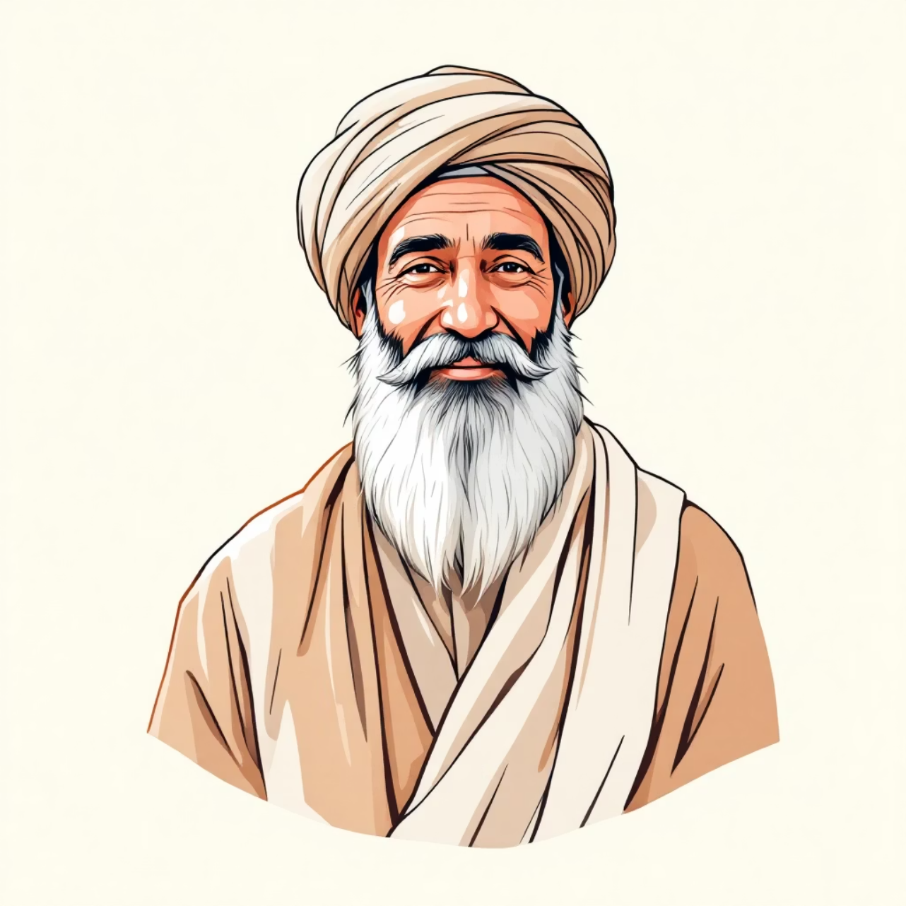
Meet Nasreddin Hodja: Turkey's Beloved Wisdom Keeper
Nasreddin Hodja is a legendary figure whose humorous tales have delighted audiences for centuries. His stories combine wit, wisdom, and social commentary.
Why His Stories Matter:
They teach life lessons through humor
They bridge generations and cultures
They preserve cultural heritage
They're perfect for digital adaptation

Slide 4

Phase 1: Building Your E-Book Foundation
Select Your Content
Write & Refine
Design Visual Elements
Choose 5-8 compelling folk tales or stories that represent your cultural heritage. Consider stories with clear lessons and engaging narratives.
Adapt traditional stories for digital reading. Keep language accessible, add context where needed, and maintain authentic cultural elements.
Create or source illustrations, choose fonts, and establish a cohesive visual style that honors the cultural origins.

Slide 5
Share Your Cultural Character
Every culture has legendary figures whose stories teach and entertain. Here's your opportunity to introduce us to yours!
1
2
3
Who Are They?
What Makes Them Special?
Why Do They Matter Today?
Introduce the character's name, origin, and historical or mythological background.
Explain their unique traits, wisdom, humor, or heroic qualities that made them memorable.
Share how their stories remain relevant and what lessons modern audiences can learn.

Slide 6

Phase 2: Transforming PDF to Flipbook
What is a Flipbook?
Key Benefits
Enhanced reader engagement
A flipbook (also called a digital flipbook) transforms static PDF documents into interactive, page-turning experiences that mimic physical books. Readers can flip pages with realistic animations, zoom in on details, and navigate easily.
Professional presentation
Easy sharing and distribution
Mobile-friendly viewing
Analytics and tracking options

Slide 7
Popular Flipbook Tools & Platforms
FlipSnack
Issuu
FlipHTML5
User-friendly platform with drag-and-drop features, templates, and publishing options. Great for beginners.
Professional publishing platform used by magazines and educators worldwide. Offers robust sharing features.
Comprehensive tool with multimedia integration, allowing you to add videos, links, and interactive elements.
BOOK Creator
We use it

Slide 8




Your Final Assignment: Create a Curriculum E-Book
Timeline: You have 2 weeks to complete this project upon returning to your home institution.
Choose Your Topic
Develop Content
Publish & Share
Select a subject from your curriculum related to the digital transformation of science and arts.
Research, write, and illustrate educational material suitable for e-book format.
Convert to flipbook and distribute to your students or colleagues.

Slide 9

Digital Transformation Topic Ideas
Science Topics
Arts Topics
Virtual laboratory experiments and simulations
Digital art techniques and tools
3D modeling in biology and chemistry
Virtual museum tours and curation
Data visualization techniques
Music production and composition software
Environmental science through digital mapping
Animation and multimedia storytelling
Astronomy and space exploration apps
Cultural heritage preservation through digitization

Slide 10

Key Takeaways & Next Steps
Practice Makes Perfect
Collaborate & Share
Focus on Quality
Start with our Nasreddin Hodja exercise to master the technical skills before tackling your curriculum project.
Exchange ideas with colleagues and learn from each other's cultural characters and digital approaches.
Ensure your content is educationally sound, visually appealing, and culturally authentic.
Remember: Digital storytelling bridges tradition and innovation. Your e-book will preserve cultural wisdom while embracing modern technology—creating lasting educational impact for future generations.

